Slide 1
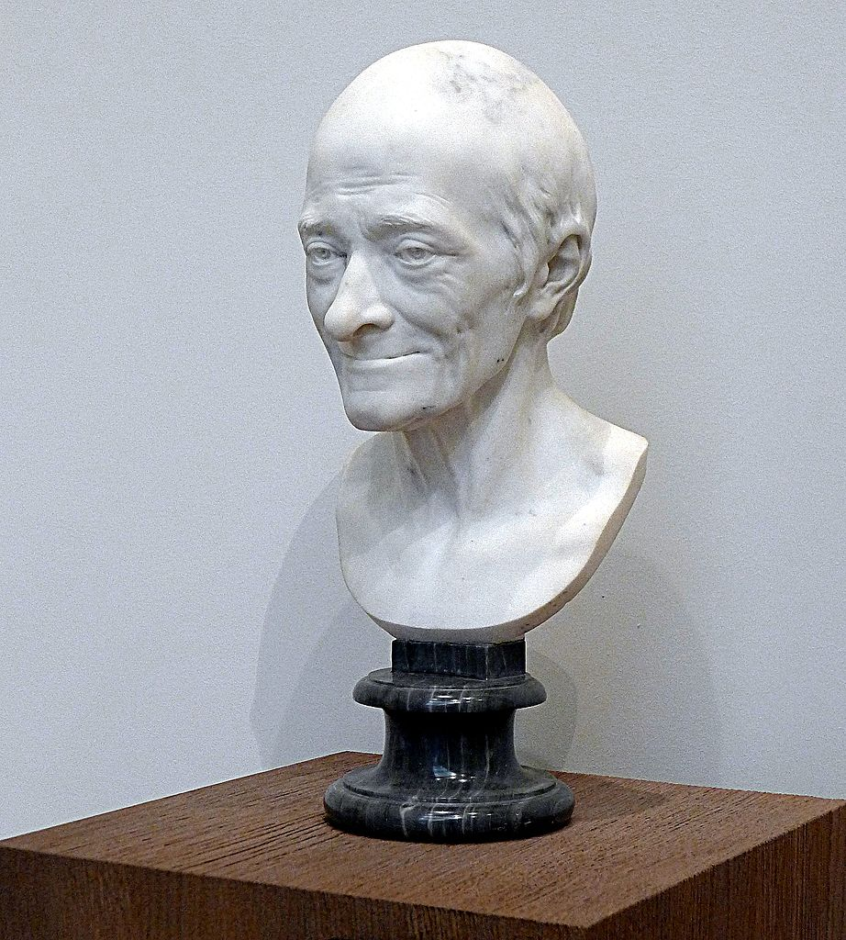
Voltaire
1694-1778
By Duncan Green

Slide 2
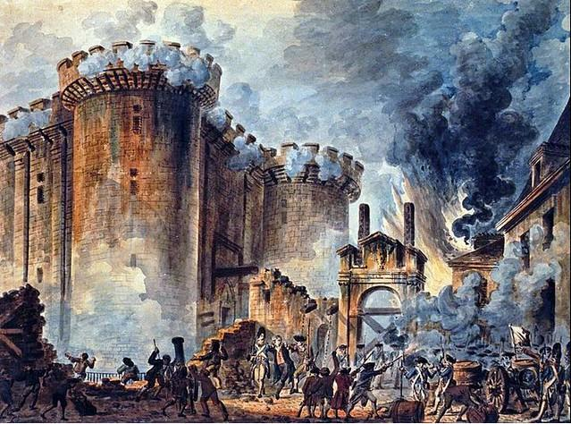
Voltaire was a French Enlightenment writer who boldly voiced his opinions, whether they got him into trouble or made enemies.
He was accused to have caused the revolution in France due to his writing against government policies and lack of censorship.
Attack of the Bastille - July 14, 1789

Slide 3
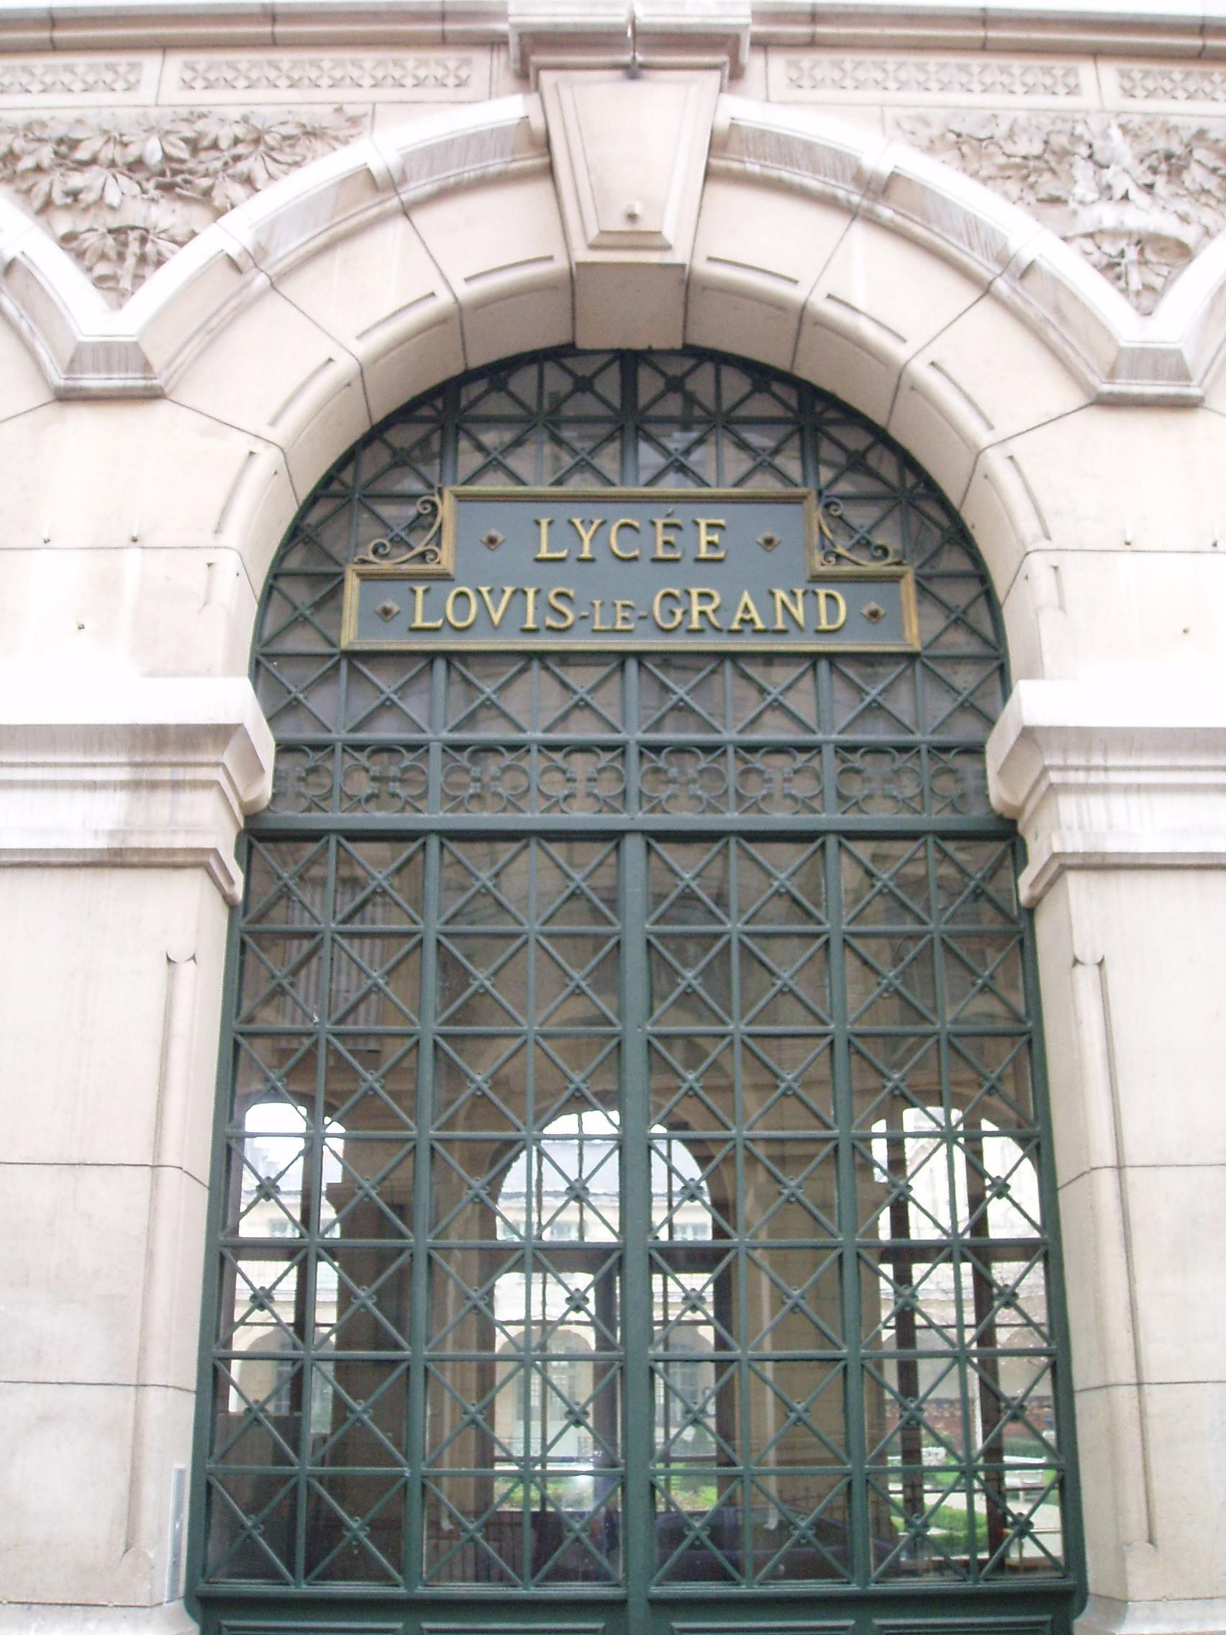
Voltaire went to Lycée Louis-le-Grand, a very prestigious college in Paris.
He aspired to be a playwright, but his father had planned for him to become a lawyer. When Voltaire tried to fulfill those plans, it ended badly. (and in legal trouble)

Slide 4
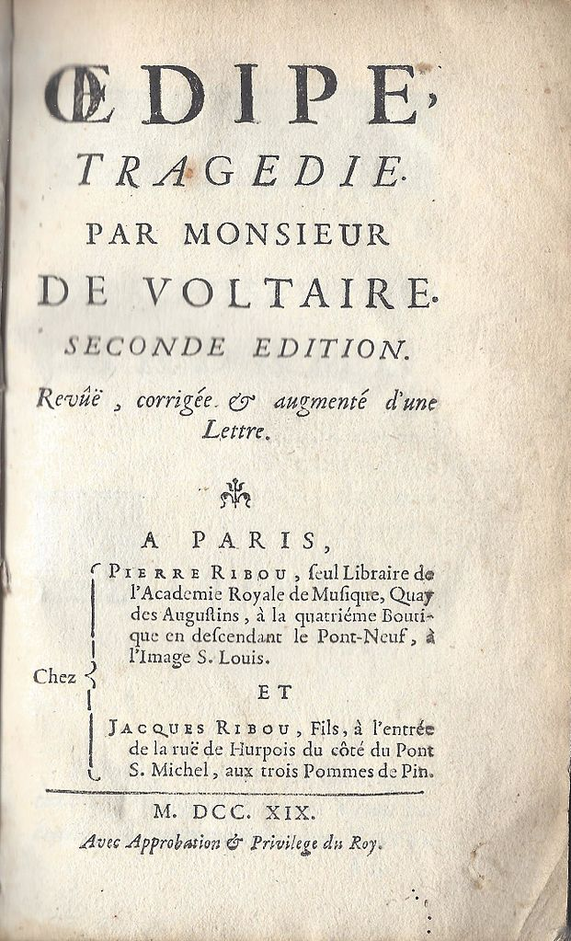
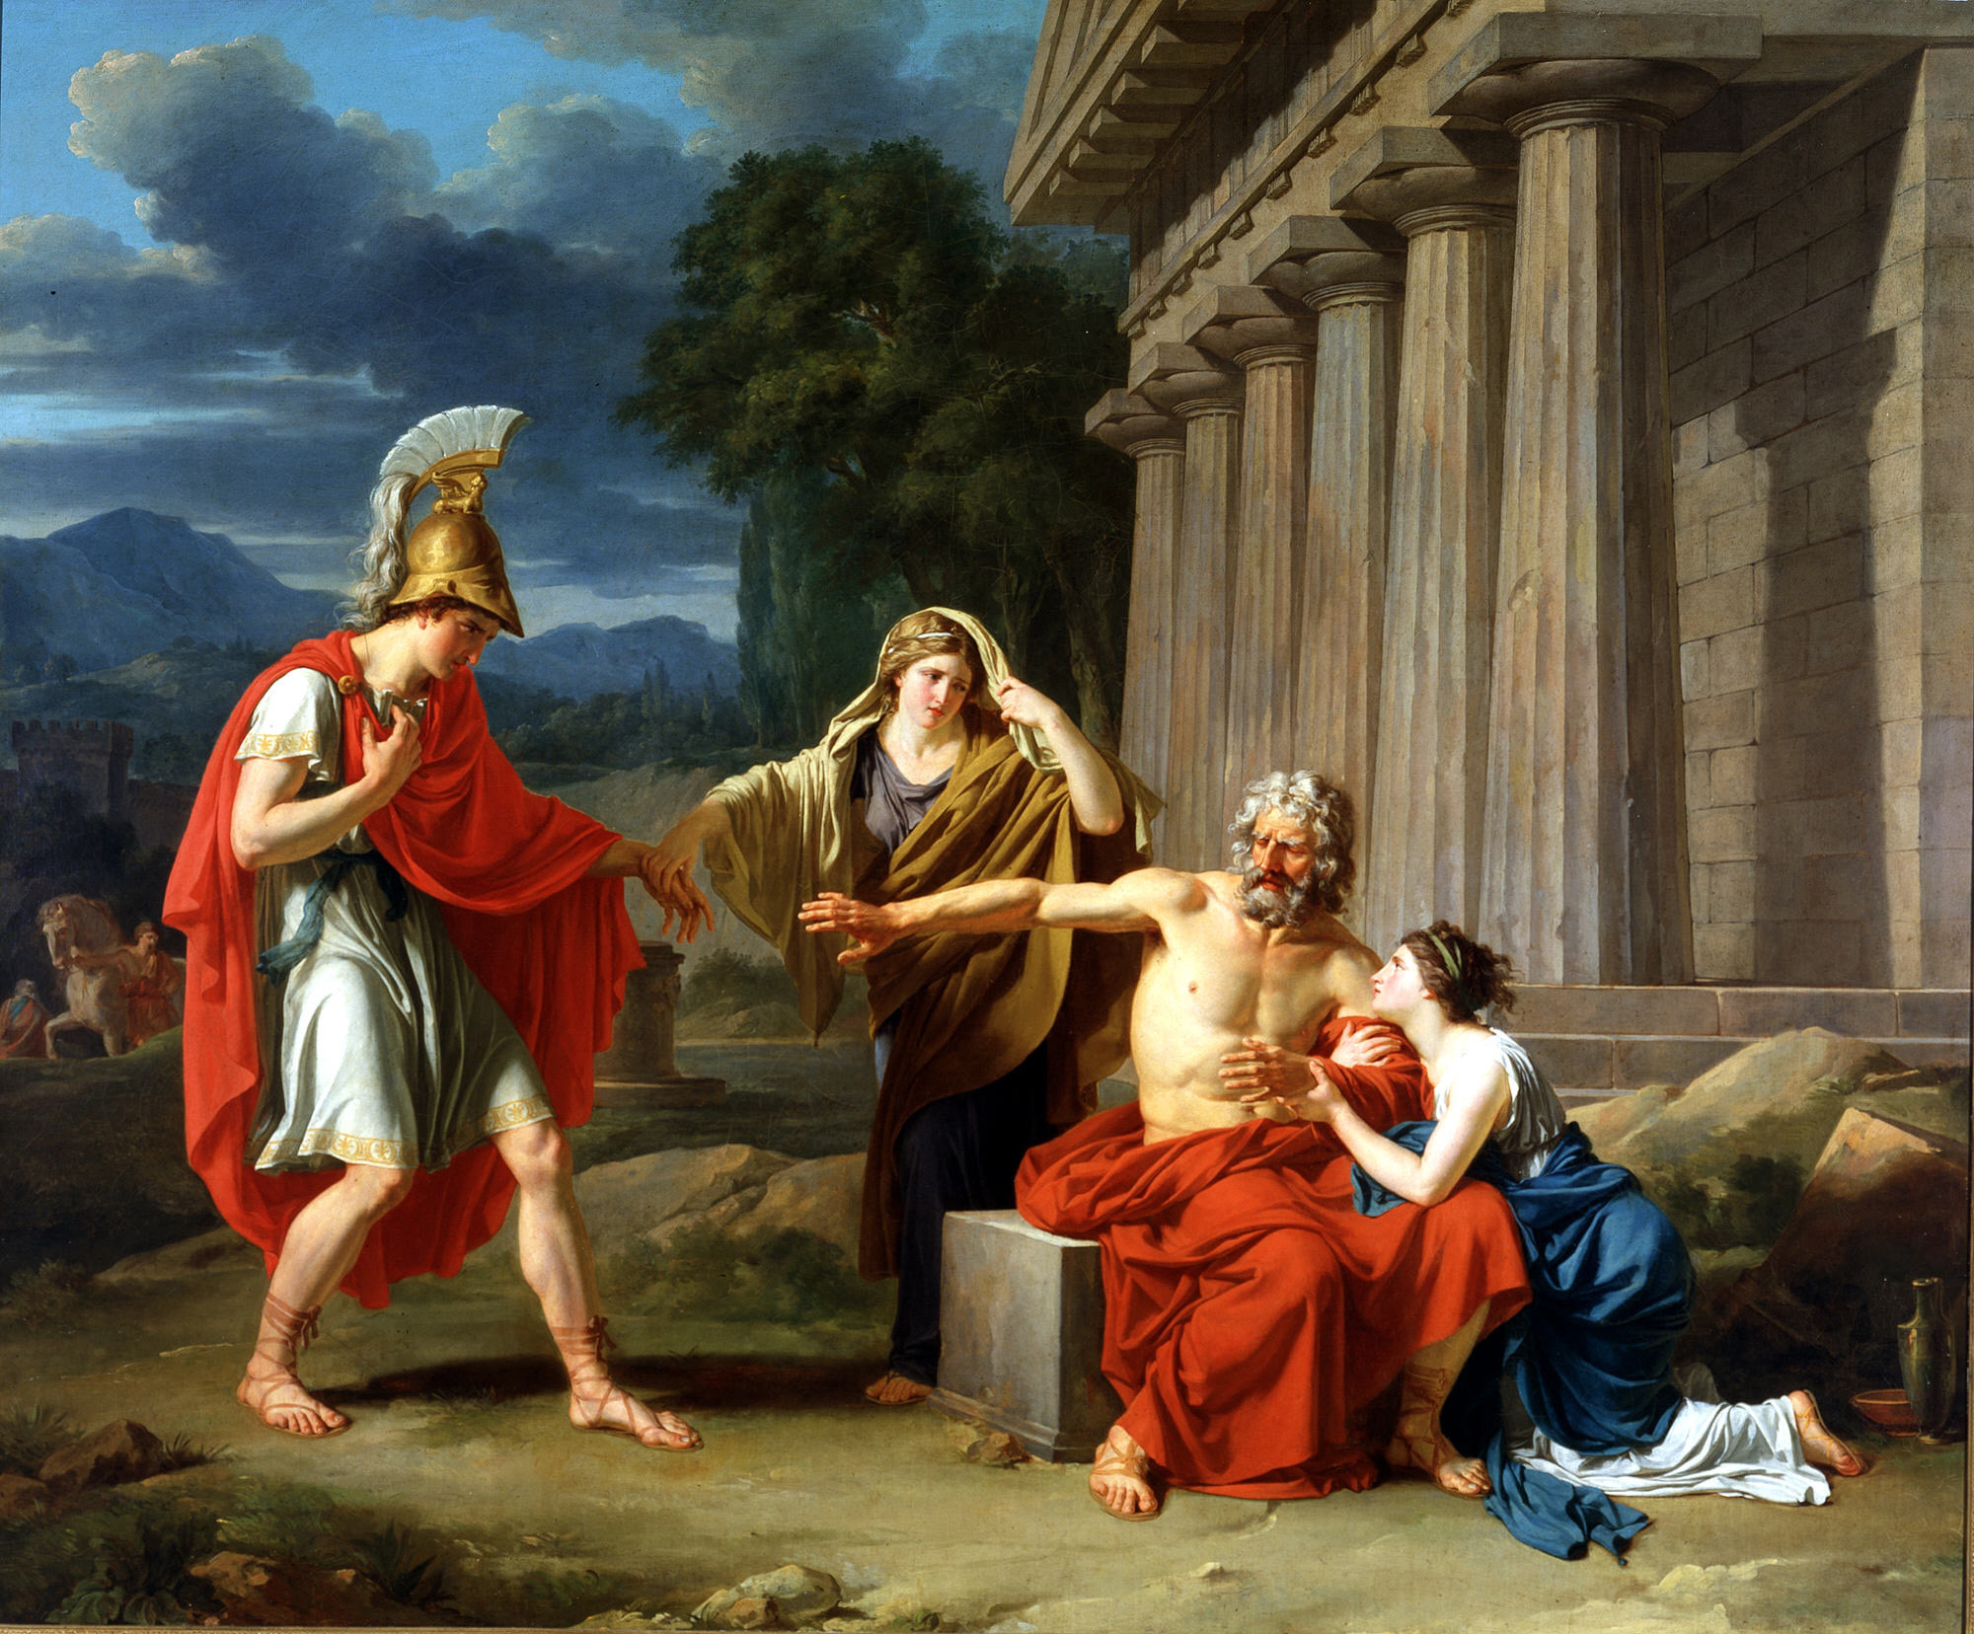
First piece of literature was the Œdipe, a play about Oedipus killing his father and marrying his mother.

Slide 5
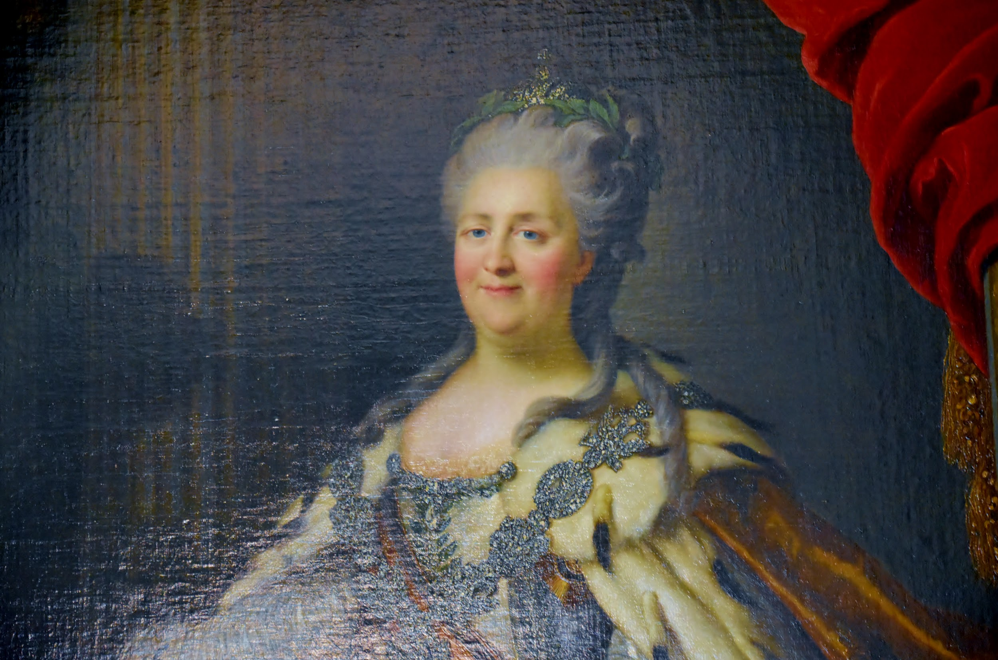
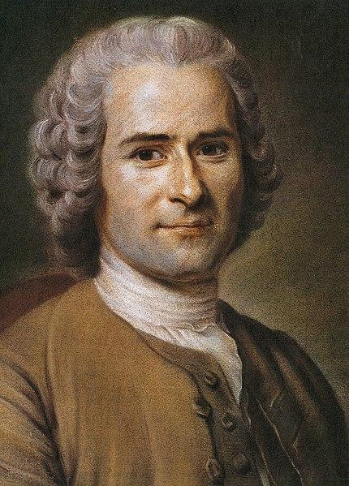
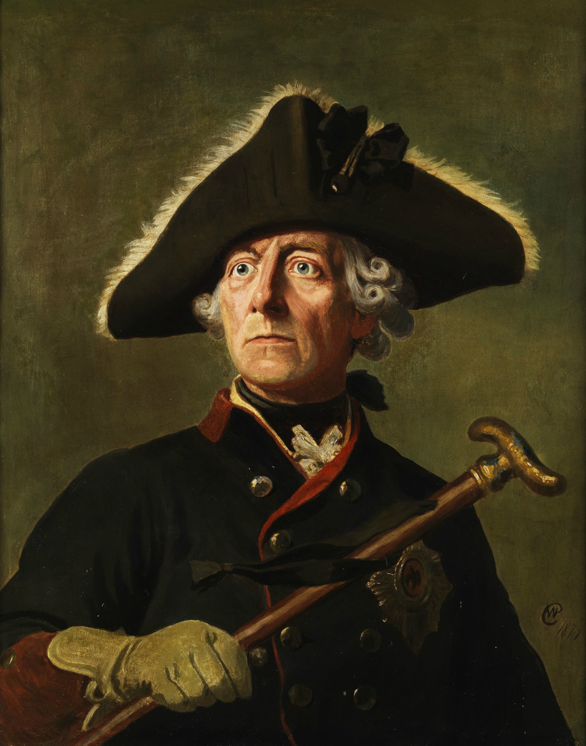
Fun Facts
His real name was François-Marie Arouet, but he is more well known by his nom de plume, or pen name - Voltaire.
Voltaire was exiled to England for three years after getting into a fight with a powerful aristocrat.
He wrote to Catherine the Great of Russia, Jean-Jacques Rousseau, an enlightenment philosopher, Frederick the Great of Prussia, among others.

Slide 6
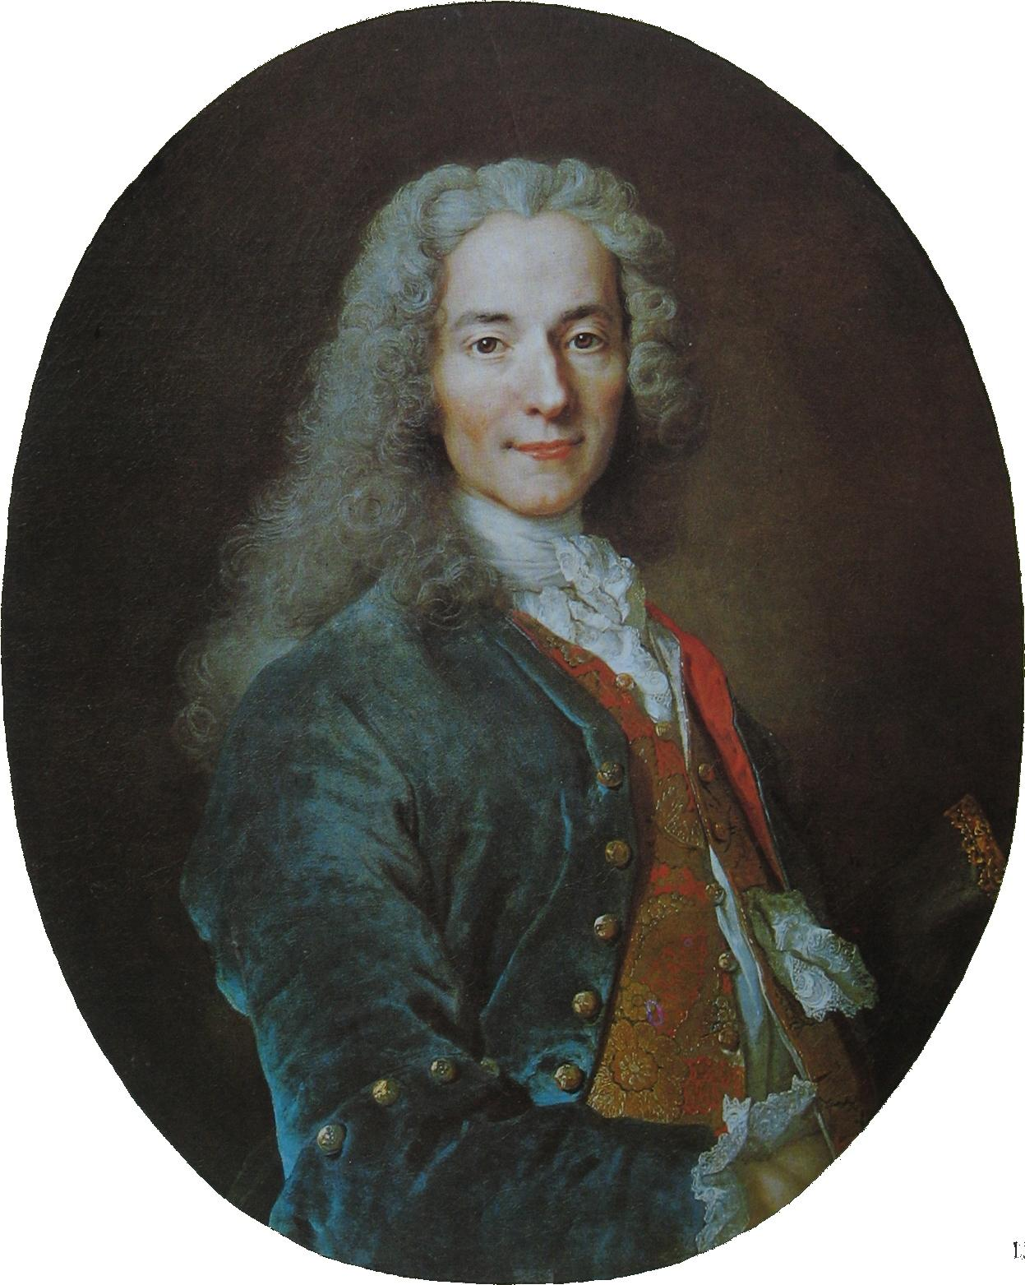
Fun Facts
Voltaire never said, “I disagree with what you say, but I will defend to the death your right to say it.”
So, what quotes did he say?
“Judge a man by his questions rather than his answers.” “In the case of news, we should always wait for the sacrament of Confirmation.”
He became very, very rich by exploiting a mathematical loophole the French National Lottery.

Slide 7
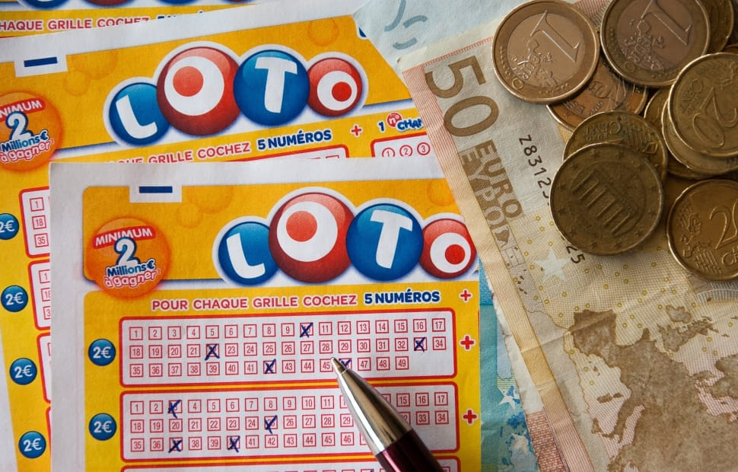
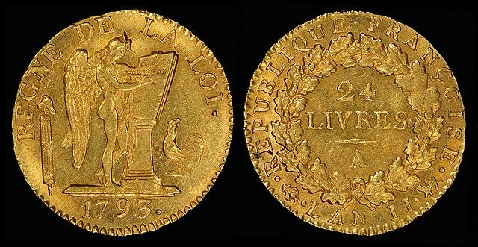
How exactly did Voltaire win so much money?
Here’s how:
In order to buy lottery tickets, you had to own a bond that the government would sell you.
The cheaper the bond, the lower price for tickets, but, they still had the same chance of winning.

Slide 8
How exactly did Voltaire win so much money?
Here’s how:
In order to buy lottery tickets, you had to own a bond that the government would sell you.
The cheaper the bond, the lower price for tickets, but, they still had the same chance of winning.
Voltaire and a few others exploited this and Voltaire himself earned about 500,000 livres, worth about 126,540,000 dollars today.

Slide 9
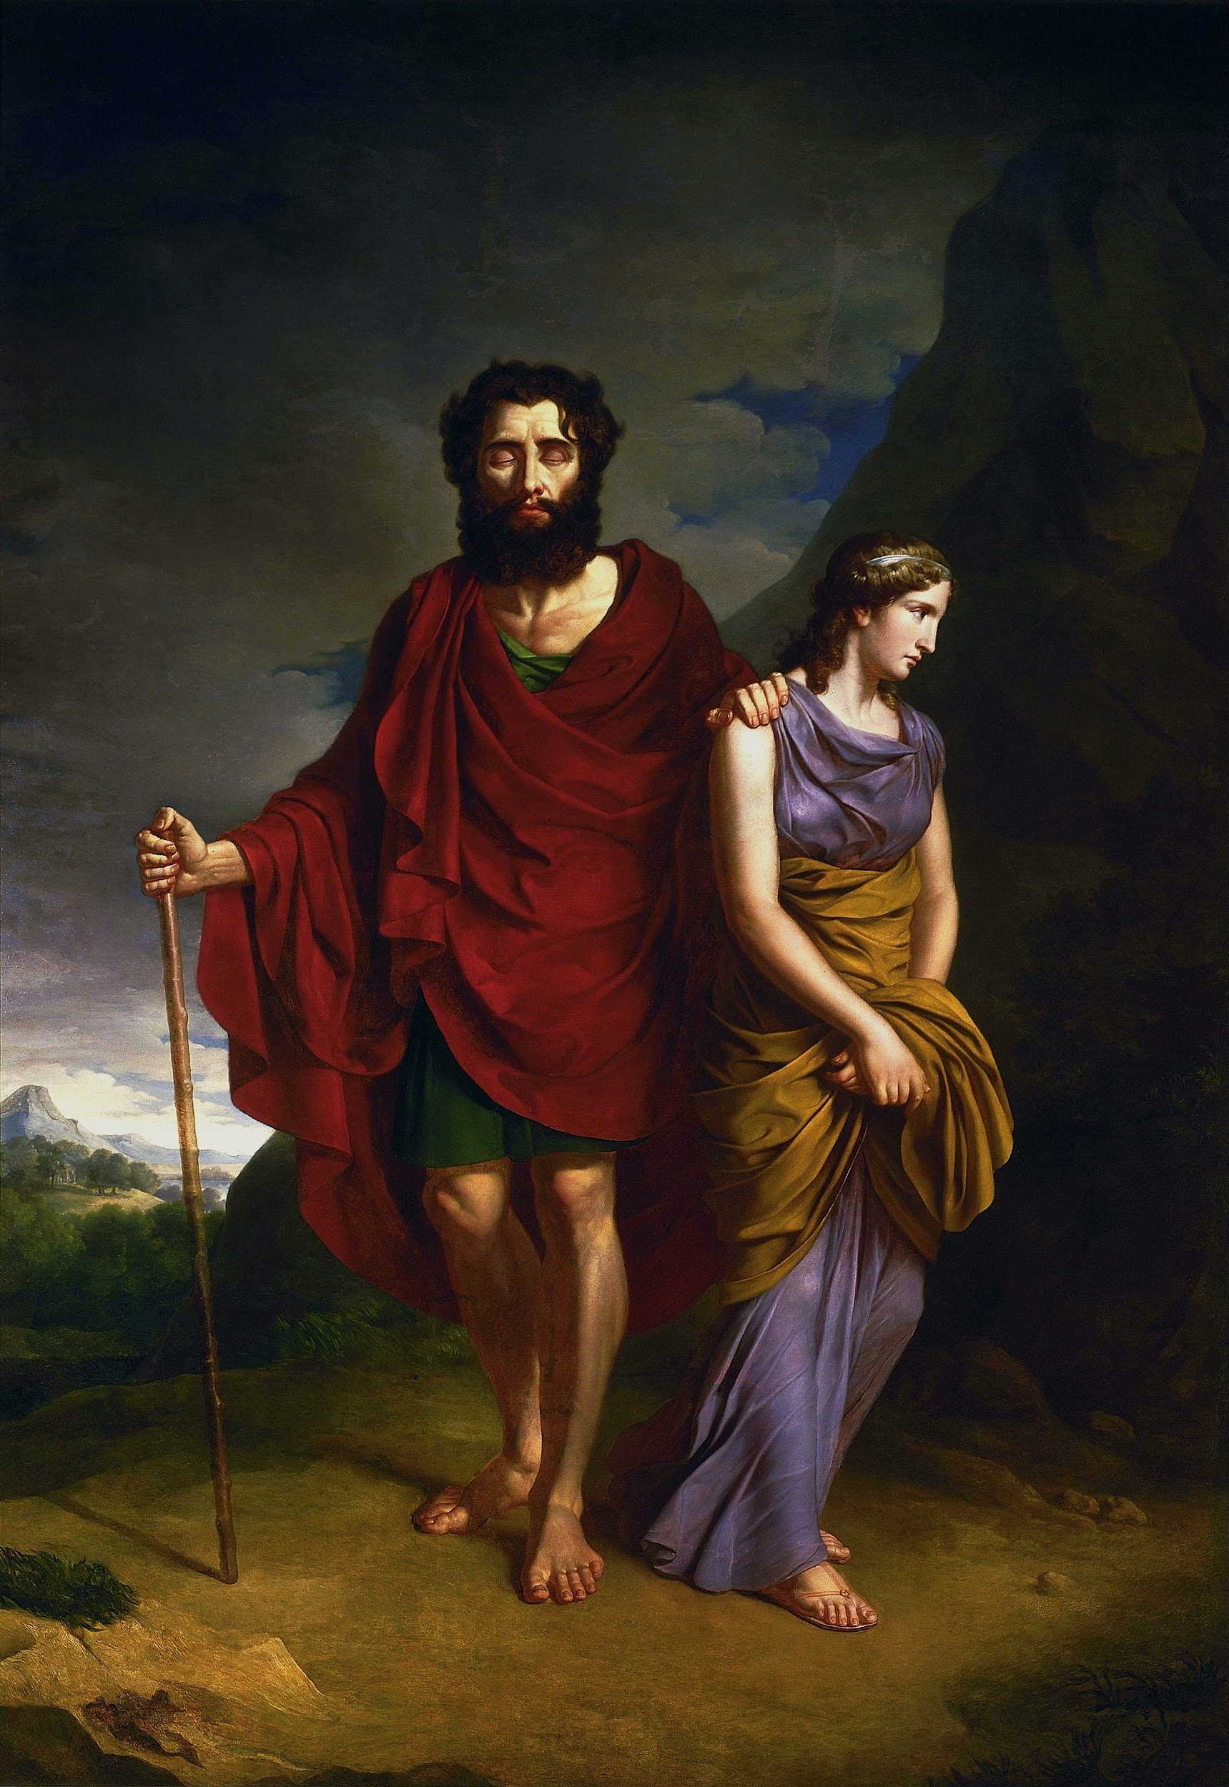
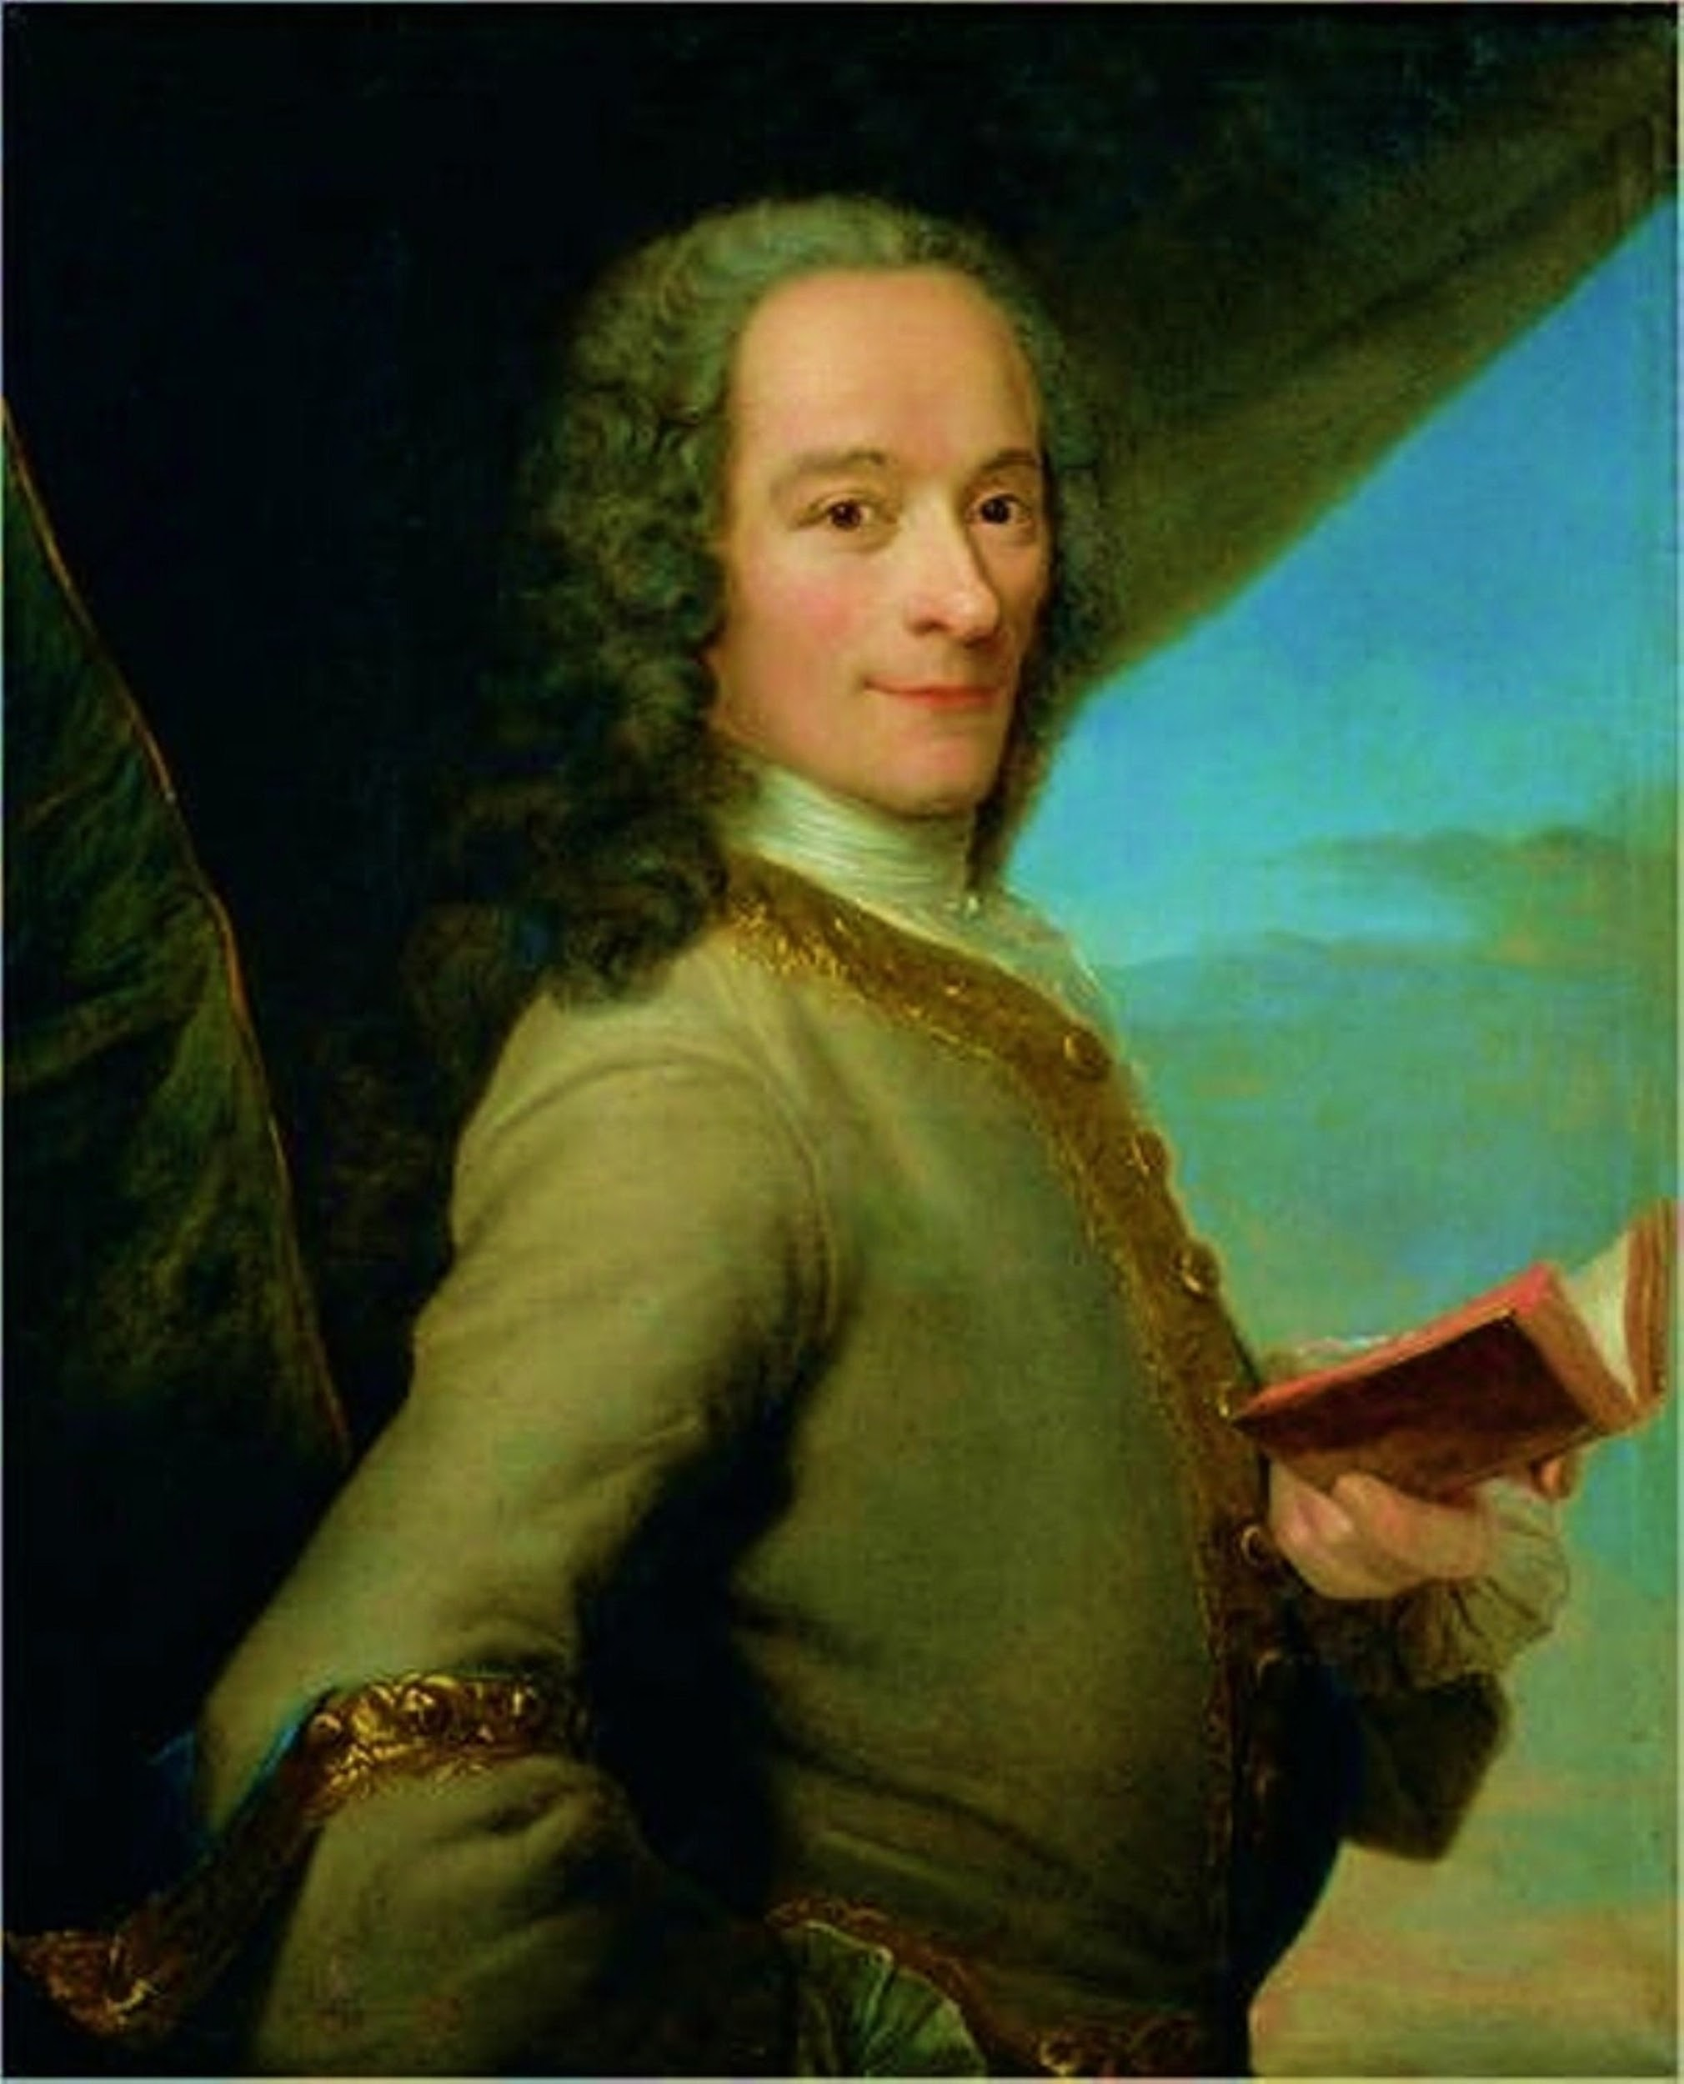
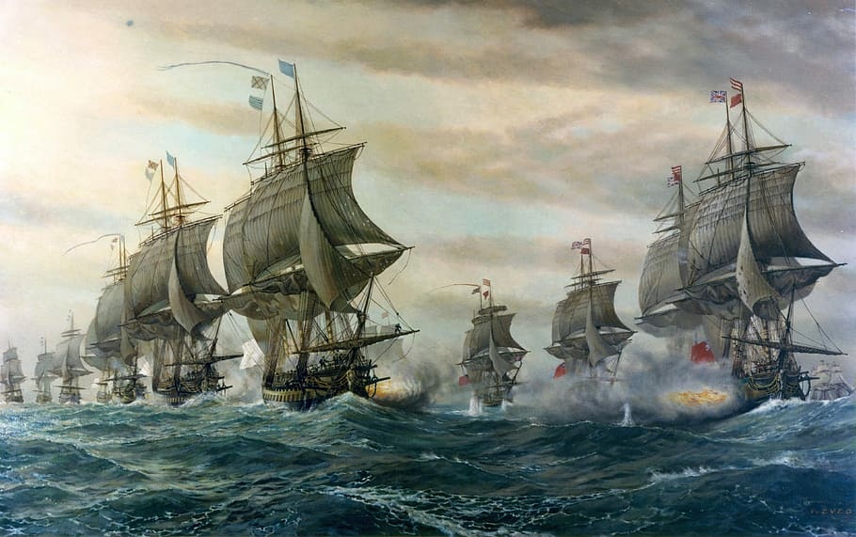
Voltaire was a French Enlightenment writer who was bold in his voicings.
He was very controversial throughout his life due to his writing and topics.
Caused a major stir in the world and helped to cause the French Revolution, moving history forward.

