Slide 1
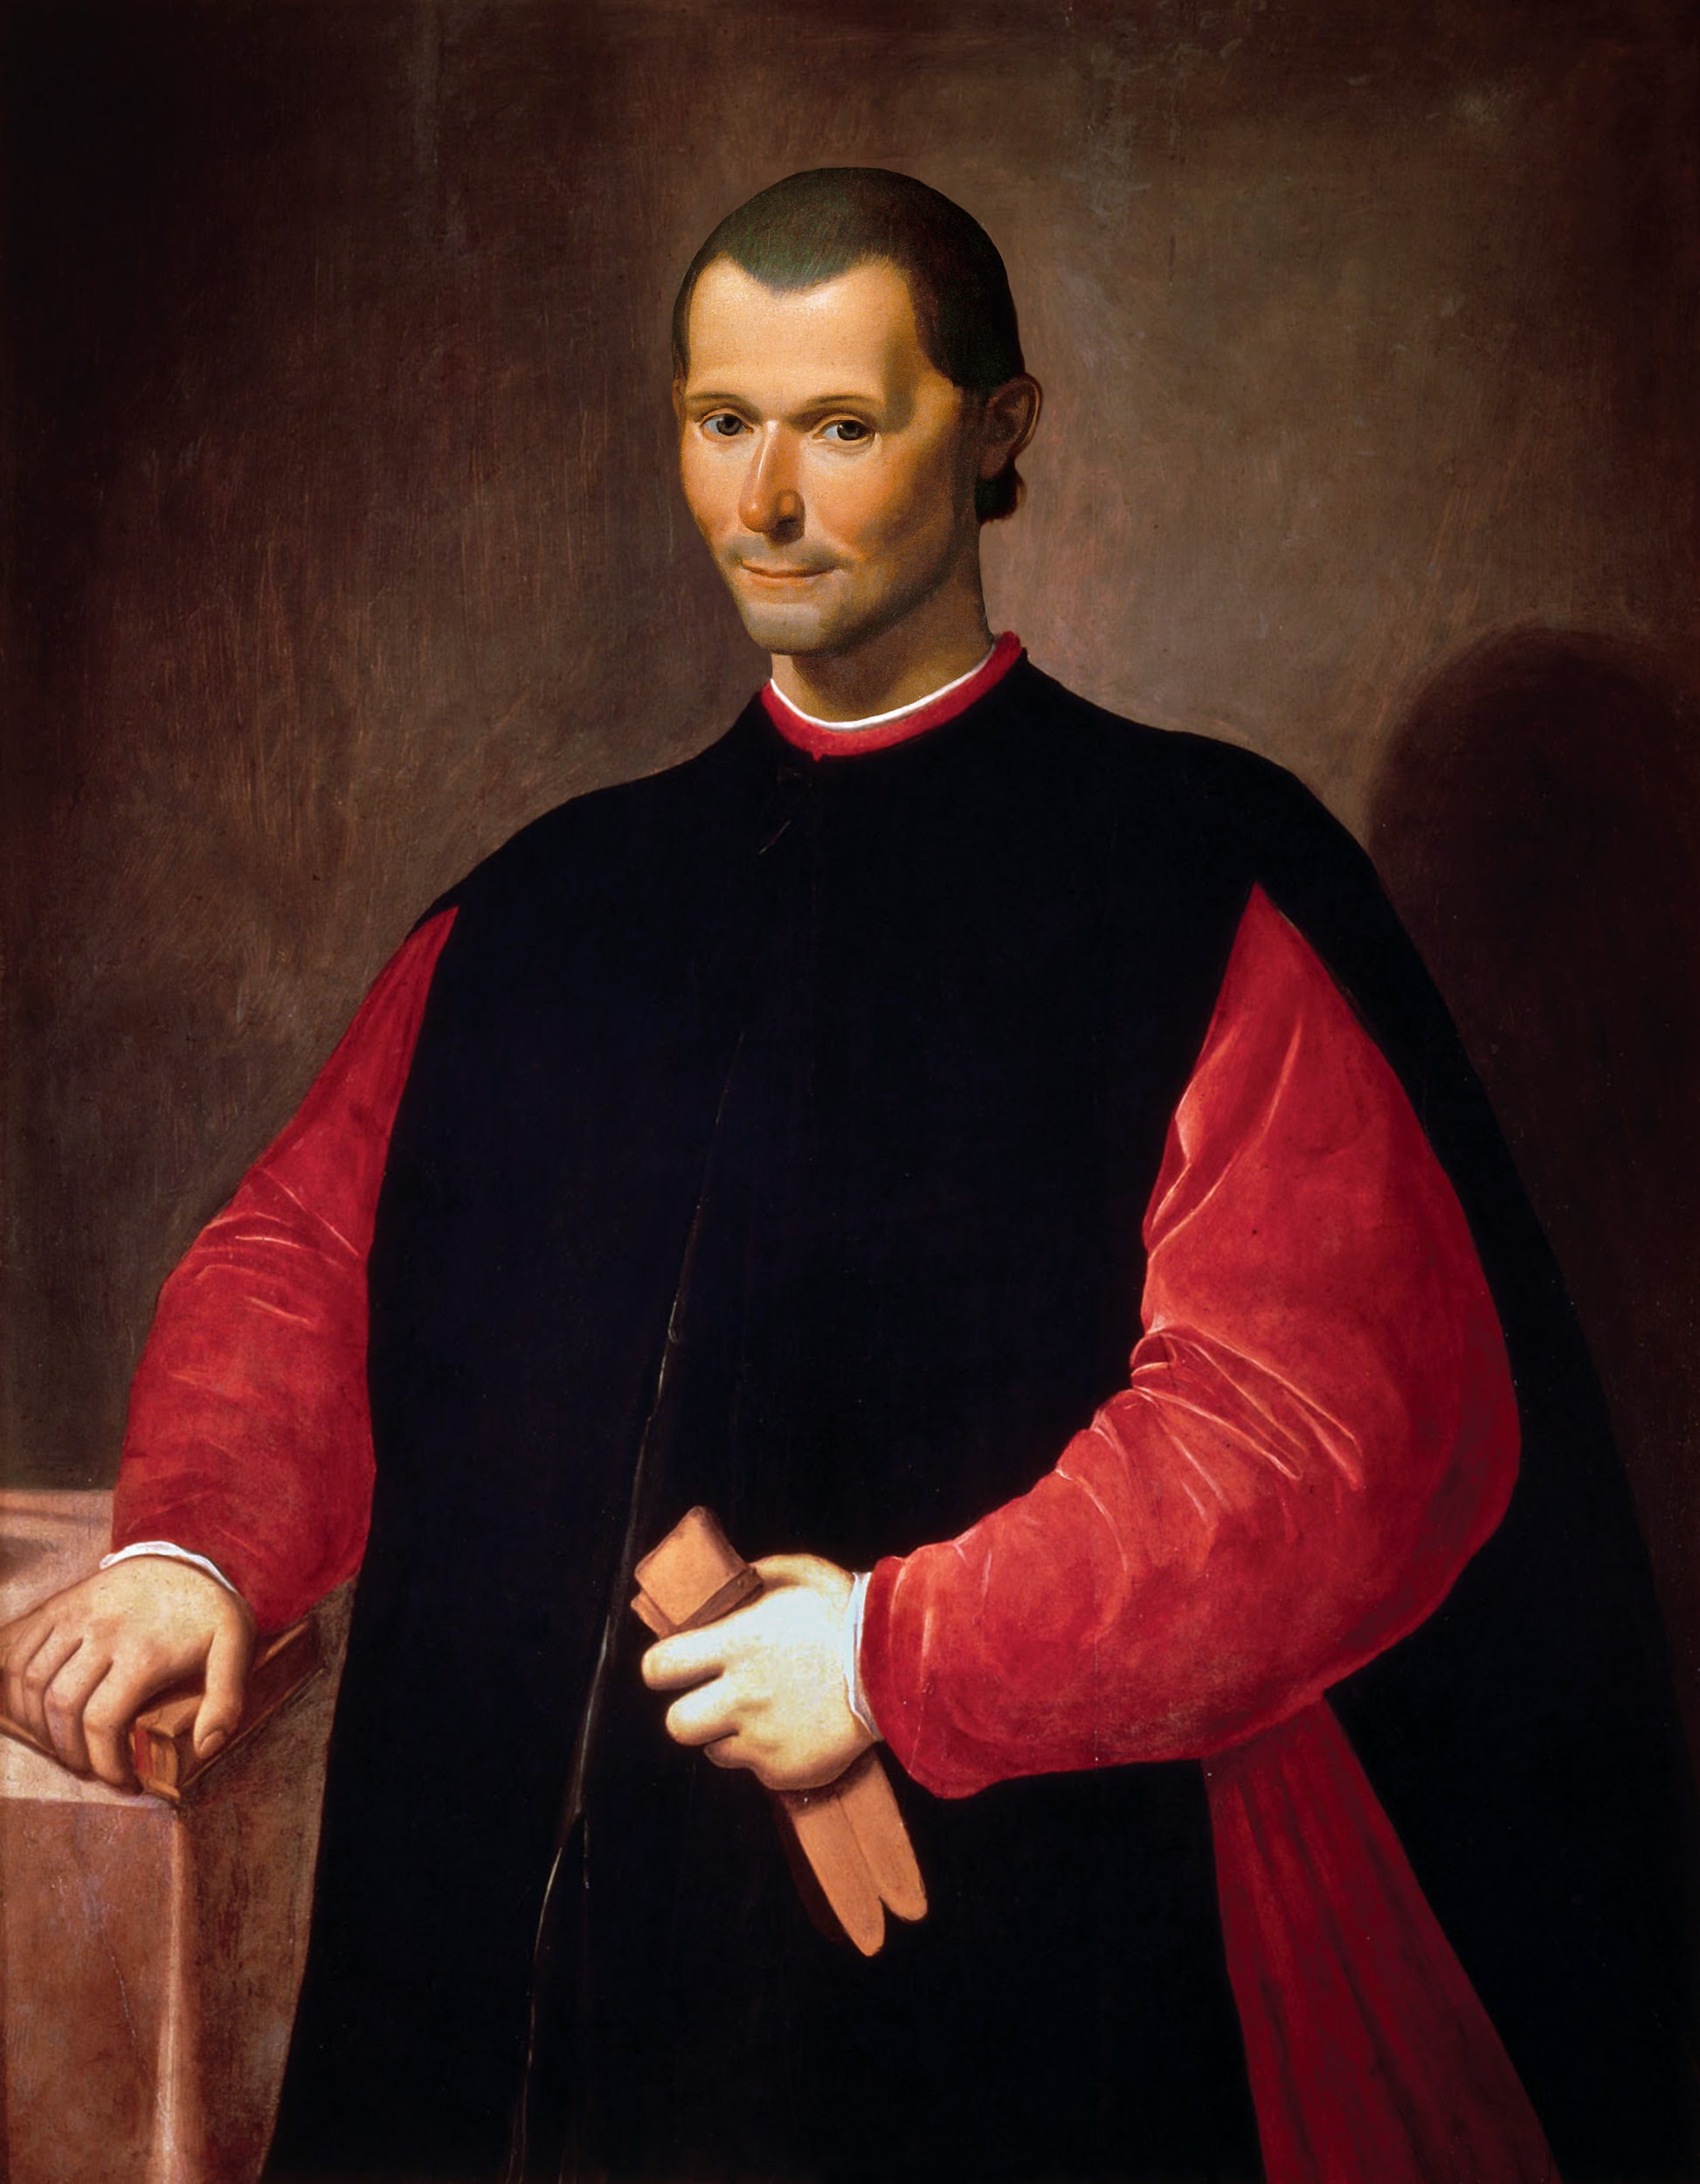
Niccolò Machiavelli
1469 - 1527
“One should not offend
a prince and later put faith in him.”
By Andrew Novak 8-W

Slide 2
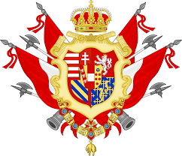
Machiavelli’s Life
He was born Florence, Italy, his beloved city.
At 29, he became head of the second chancery. It placed him in charge of the republic’s foreign affairs. He was very young to be holding this high position.
His family is believed to have descended from the rulers of Tuscany, who were the most important family.

Slide 3
Machiavelli’s Life
Machiavelli’s family was wealthy and prominent, holding on occasion Florence’s most important offices.
His father, Bernardo, a doctor of laws, was nevertheless among the family’s poorest members.
This was because his father was the youngest child, so he got the least amount of money.

Slide 4
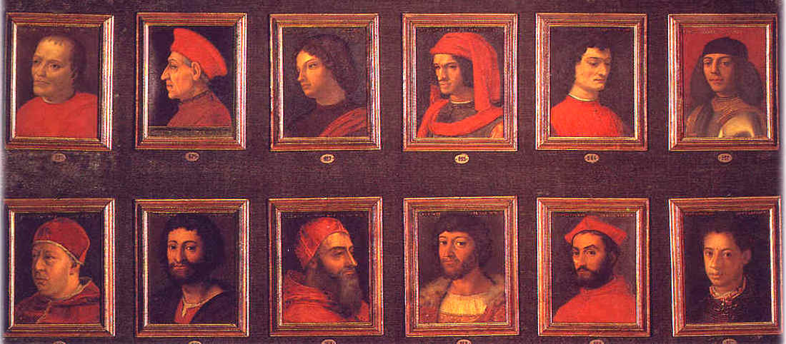
Machiavelli’s Life
Altogether, Machiavelli embarked on more than 40 diplomatic missions during his 14 years at the chancery.
In 1512, the Florentine republic was overthrown. The Medici family returned to rule Florence.
Machiavelli, suspected of conspiracy to overthrow the Medici family, was imprisoned, tortured, and sent into exile in 1513 to San Casciano, just south of Florence.
During his exile, he wrote The Prince and Discourses on Livy.

Slide 5
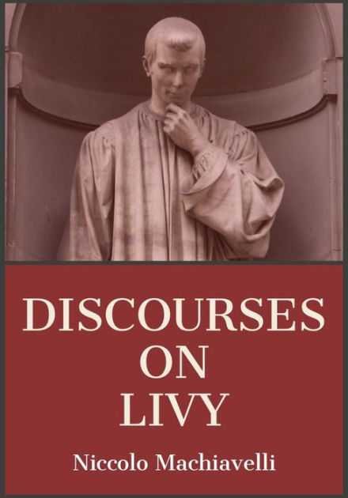
Discourses of Livy
Discourses on Livy, or more precisely, Discourses on the first ten books of Titus Livy.
It was first published after his death.
The Discourses on Livy is about how to preserve a republic.
It criticized the Roman Catholic Church and Christianity.
He says it contains everything he knows.

Slide 6
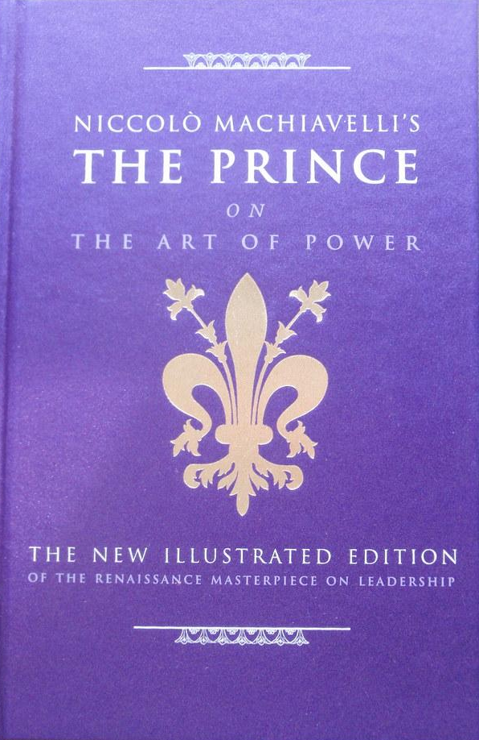
The Prince
Machiavelli’s most famous work is The Prince.
It is about the possibility of a “new prince”, a new ruler. It is about a prince who gains control of a kingdom and has to retain power. He does this by balancing the interests of the people with the law.
This book was written for Lorenzo de’ Medici on how to stay in power.
He wrote The Prince after his conspiracy against the Medici’s.
It brings Machiavelli a reputation as an atheist and an immoral cynic.

Slide 7
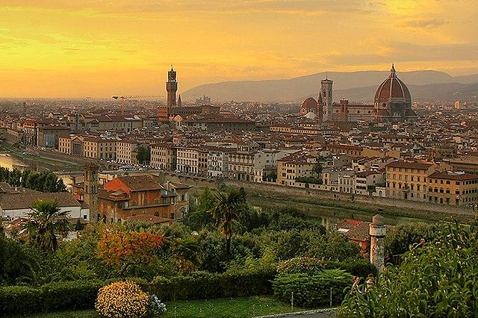
In Summary…
He was born and died in Florence.
He was suspected of conspiracy, so he was tortured and exiled.
During exile, he wrote The Prince and The Discourses on Livy.
These two books are his most famous works and they were both published after his death.
The Discourses on Livy is about how to rule and preserve a republic.
The Prince was written for Lorenzo de’ Medici on how to stay in power.

