Slide 1

Strategies for Helping Children with Organization, Study Skills and Homework

Slide 2
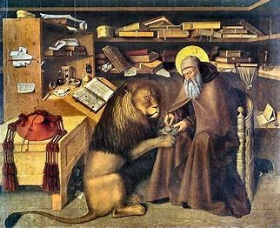
Organization is Key
Good, better, best. Never let it rest. ‘Til your good is better and your better is best.
- St. Jerome

Slide 3

Tips for Students on Organizing Your Materials
Get everything ready for school (backpack, clothes, lunch, etc.) before going to bed at night and keep it in a consistent spot.
Write down assignments in the same planner every day and bring it home. Check it every night after completing homework to be sure everything is completed.
Look in your desk every day before leaving school to make sure you have everything you need.
Follow teacher directions about where to put papers returned to you.

Slide 4
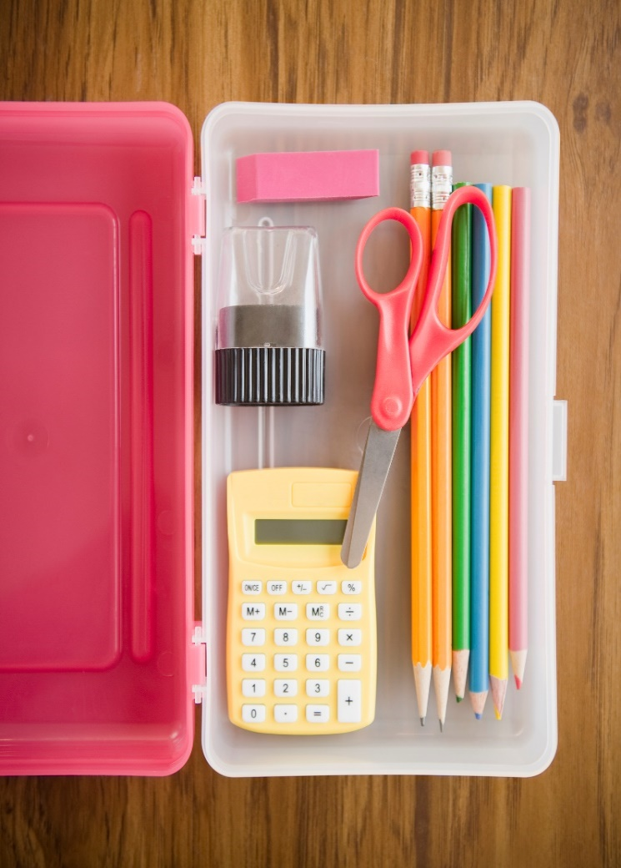
Tips for Students on Organizing Your Materials
Don’t leave anything in your desk or backpack that you don’t need for school (trash, toys, old papers).
Keep all your home study materials in your study spot (paper, pencils, calculator, etc.).
Have a grownup help you stay organized daily.
Make a special time daily to do your homework. Keep to that schedule.

Slide 5

Time Management Tips for Students
Be ready when you sit down to study – have all books and materials in your study spot.
Do the hardest assignments first – save easiest for last.
If you get sleepy or can’t concentrate, get up and take a break – move around or get a snack.

Slide 6

Time Management Tips for Students
Study using techniques that match your learning style.
Study for a few nights before a test – review what you learned in the morning before school.
If you are absent one day, catch up right away – don’t get behind!

Slide 7
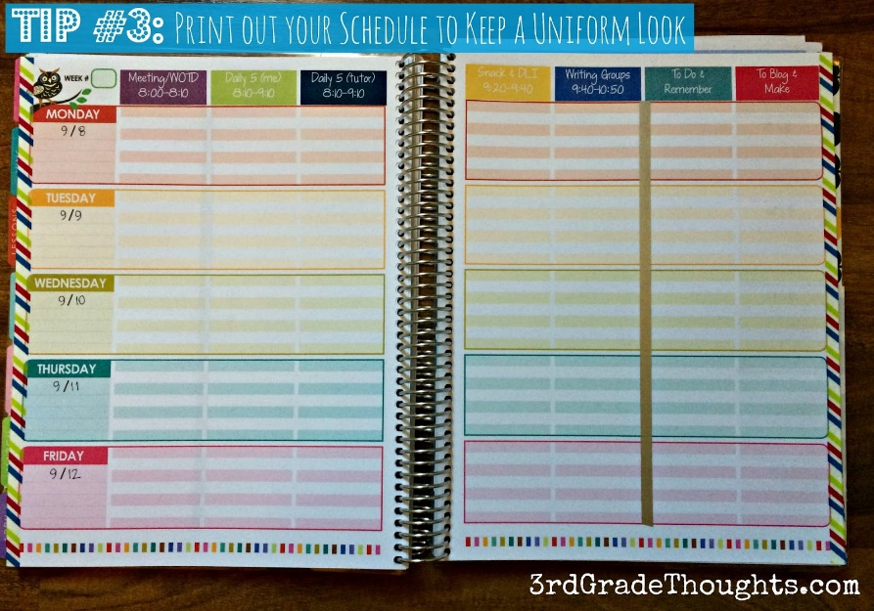
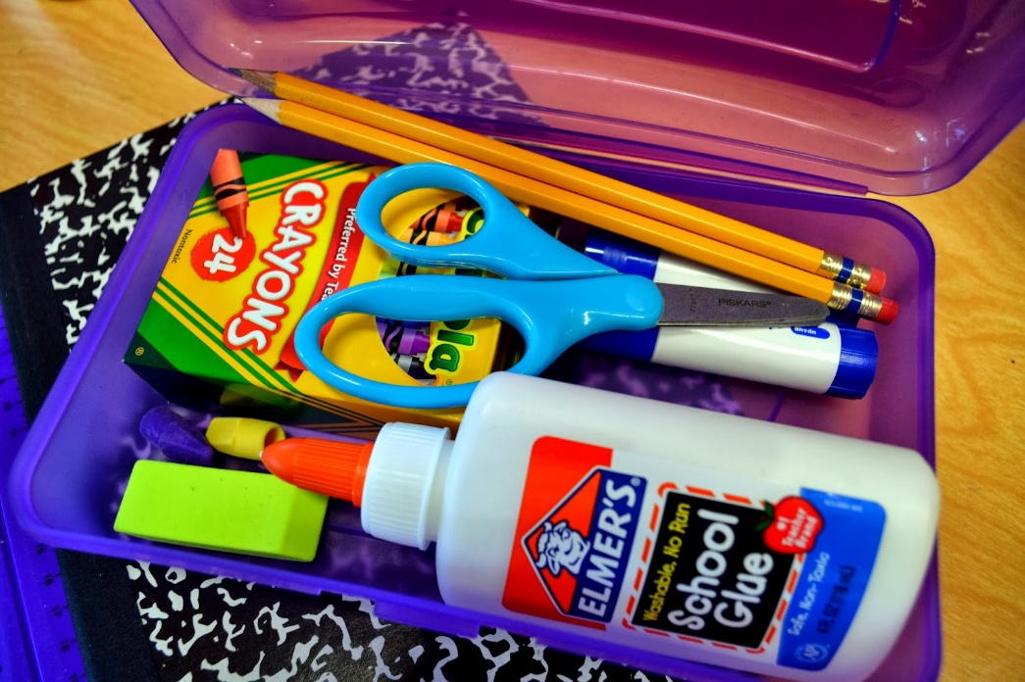
Organizational Tools
Planner
Folders – color coded w/books
Notebooks – color coded w/books
File tabs
Binder
Pencil case
This Photo by Unknown Author is licensed under CC BY-NC

Slide 8
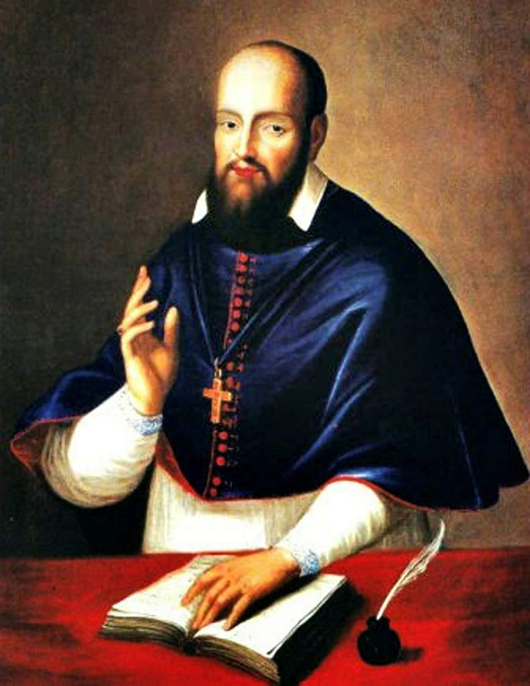
Study Skills
You learn to speak by speaking, to study by studying, to run by running, to work by working; and just so, you learn to love by loving. All those who think to learn in any other way deceive themselves.
- Saint Francis de Sales

Slide 9



Learning Styles
Visual – learn by seeing
Auditory – learn by hearing
Kinesthetic – learn by doing
Everyone learns differently – study in ways that are most helpful to you!

Slide 10
Visual Learners
Visual Learners
Highlight or underline main ideas.
Make an outline or map of main ideas.
To study for a test, do something you can see – lists, drawing, copying words, etc.
Use index cards to make flashcards – separate into “know” and “don’t know” piles, play memory game, etc.
Use a computer or draw on a chalkboard as you study.
Use assignment book to write down assignments daily,
Never watch TV while you are studying!

Slide 11
Visual Learners
Auditory Learners
Read aloud instead of silently.
Tape record items to study and play the information back – recite along with tape.
Use music to help you learn – put information to a tune you know or make up a song or poem.
Have another person quiz you and review information aloud.
Study in a quiet place with no distractions.

Slide 12
Visual Learners
Kinesthetic Learners
Use objects (like coins, beans, blocks, etc.) to help you understand math.
Trace spelling or vocabulary words in sand or salt or use magnetic letters to spell words out on fridge.
Use maps, globes, puzzles to study history and geography.
“Teach” the information you must learn to someone else using a chalkboard to write or draw the information.
Have someone talk through the information with you while you do something active: shoot baskets, jump rope, walk around, etc.
Take breaks often during study time.
Have adult help you develop a system to stay organized.

Slide 13

Study Environment
(should be comfortable, but not too relaxing)
Place:
  Choose a place where you are able to write neatly and stay alert.
  Try to study in the same place every day but if not possible, have necessary supplies in your backpack.
Light:
  Use good overhead lighting that is not too dim but not so bright that you must squint.
Sound:
  Find a quiet place where you aren’t interrupted by others, the radio or TV, or other noises.
Temperature:
  Find a comfortable spot where you are not too hot or too cold.
Where is your study spot? Does it meet the criteria above?

Slide 14
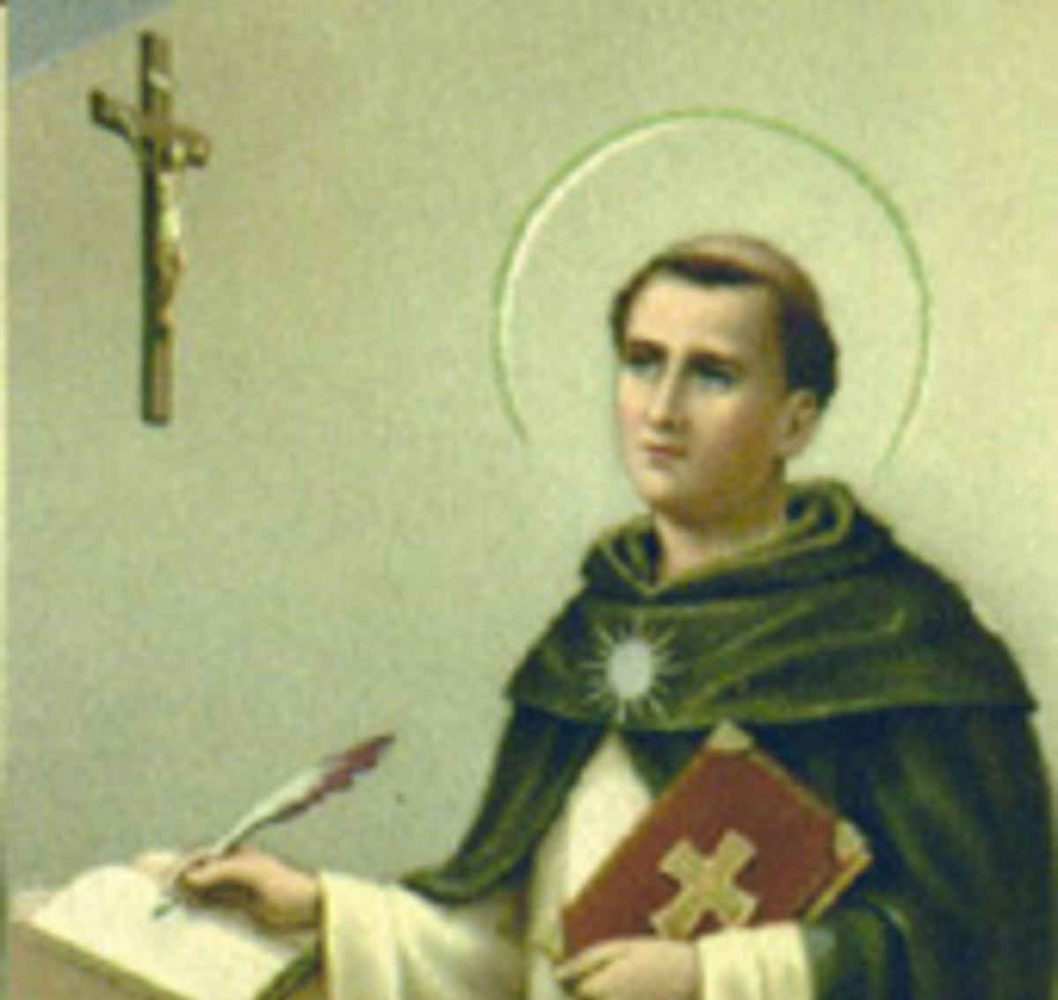
A Prayer for Students by St. Thomas Aquinas
Come, Holy Spirit, Divine Creator, true source of light and fountain of wisdom!
Pour forth your brilliance upon my dense intellect, dissipate the darkness which covers me, that of sin and of ignorance.
Grant me a penetrating mind to understand, a retentive memory, method and ease in learning, the lucidity to comprehend, and abundant grace in expressing myself.
Guide the beginning of my work, direct its progress, and bring it to successful completion.
This I ask through Jesus Christ, true God and true man, living and reigning with You and the Father, forever and ever.
Amen.

Slide 15
Acknowledgements
Adapted from a presentation by Karen McIntyre
With information from
Study Skills by Kelly Wingate
Homework Without Tears by Lee Canter

