Slide 1
MARCUS CICERO
By: Joe Vanore

Slide 2
BIRTH/DEATH/LIFE
He was born 100 bc, Arpinum, a little town south of Rome.
Cicero was born into a rich family, but was not apart of the aristocracy of rome. His family had strong military connections
He was executed by the followers of Caesar at the age of 60

Slide 3
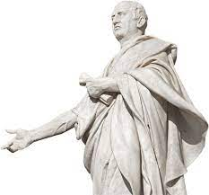
CICERO’S LEGACY
Cicero is widely considered to be the master of latin prose.
He was a lawyer, a philosopher, a roman constitutionalist, and even a political theorist.

Slide 4
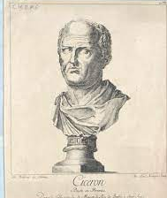
CICERO’S IDEALS
Cicero proposed that the ideal government:
“Is formed by an equal balancing and blending” of monarchy, democracy, and aristocracy.

Slide 5
SOME OF CICERO’S QUOTES
“A room without books is like a body without a soul”
“The life of the dead is placed in the memory of the living”
“While there is life, there’s hope.”
“Any man can make mistakes, but only an idiot persists in his error.”

Slide 6
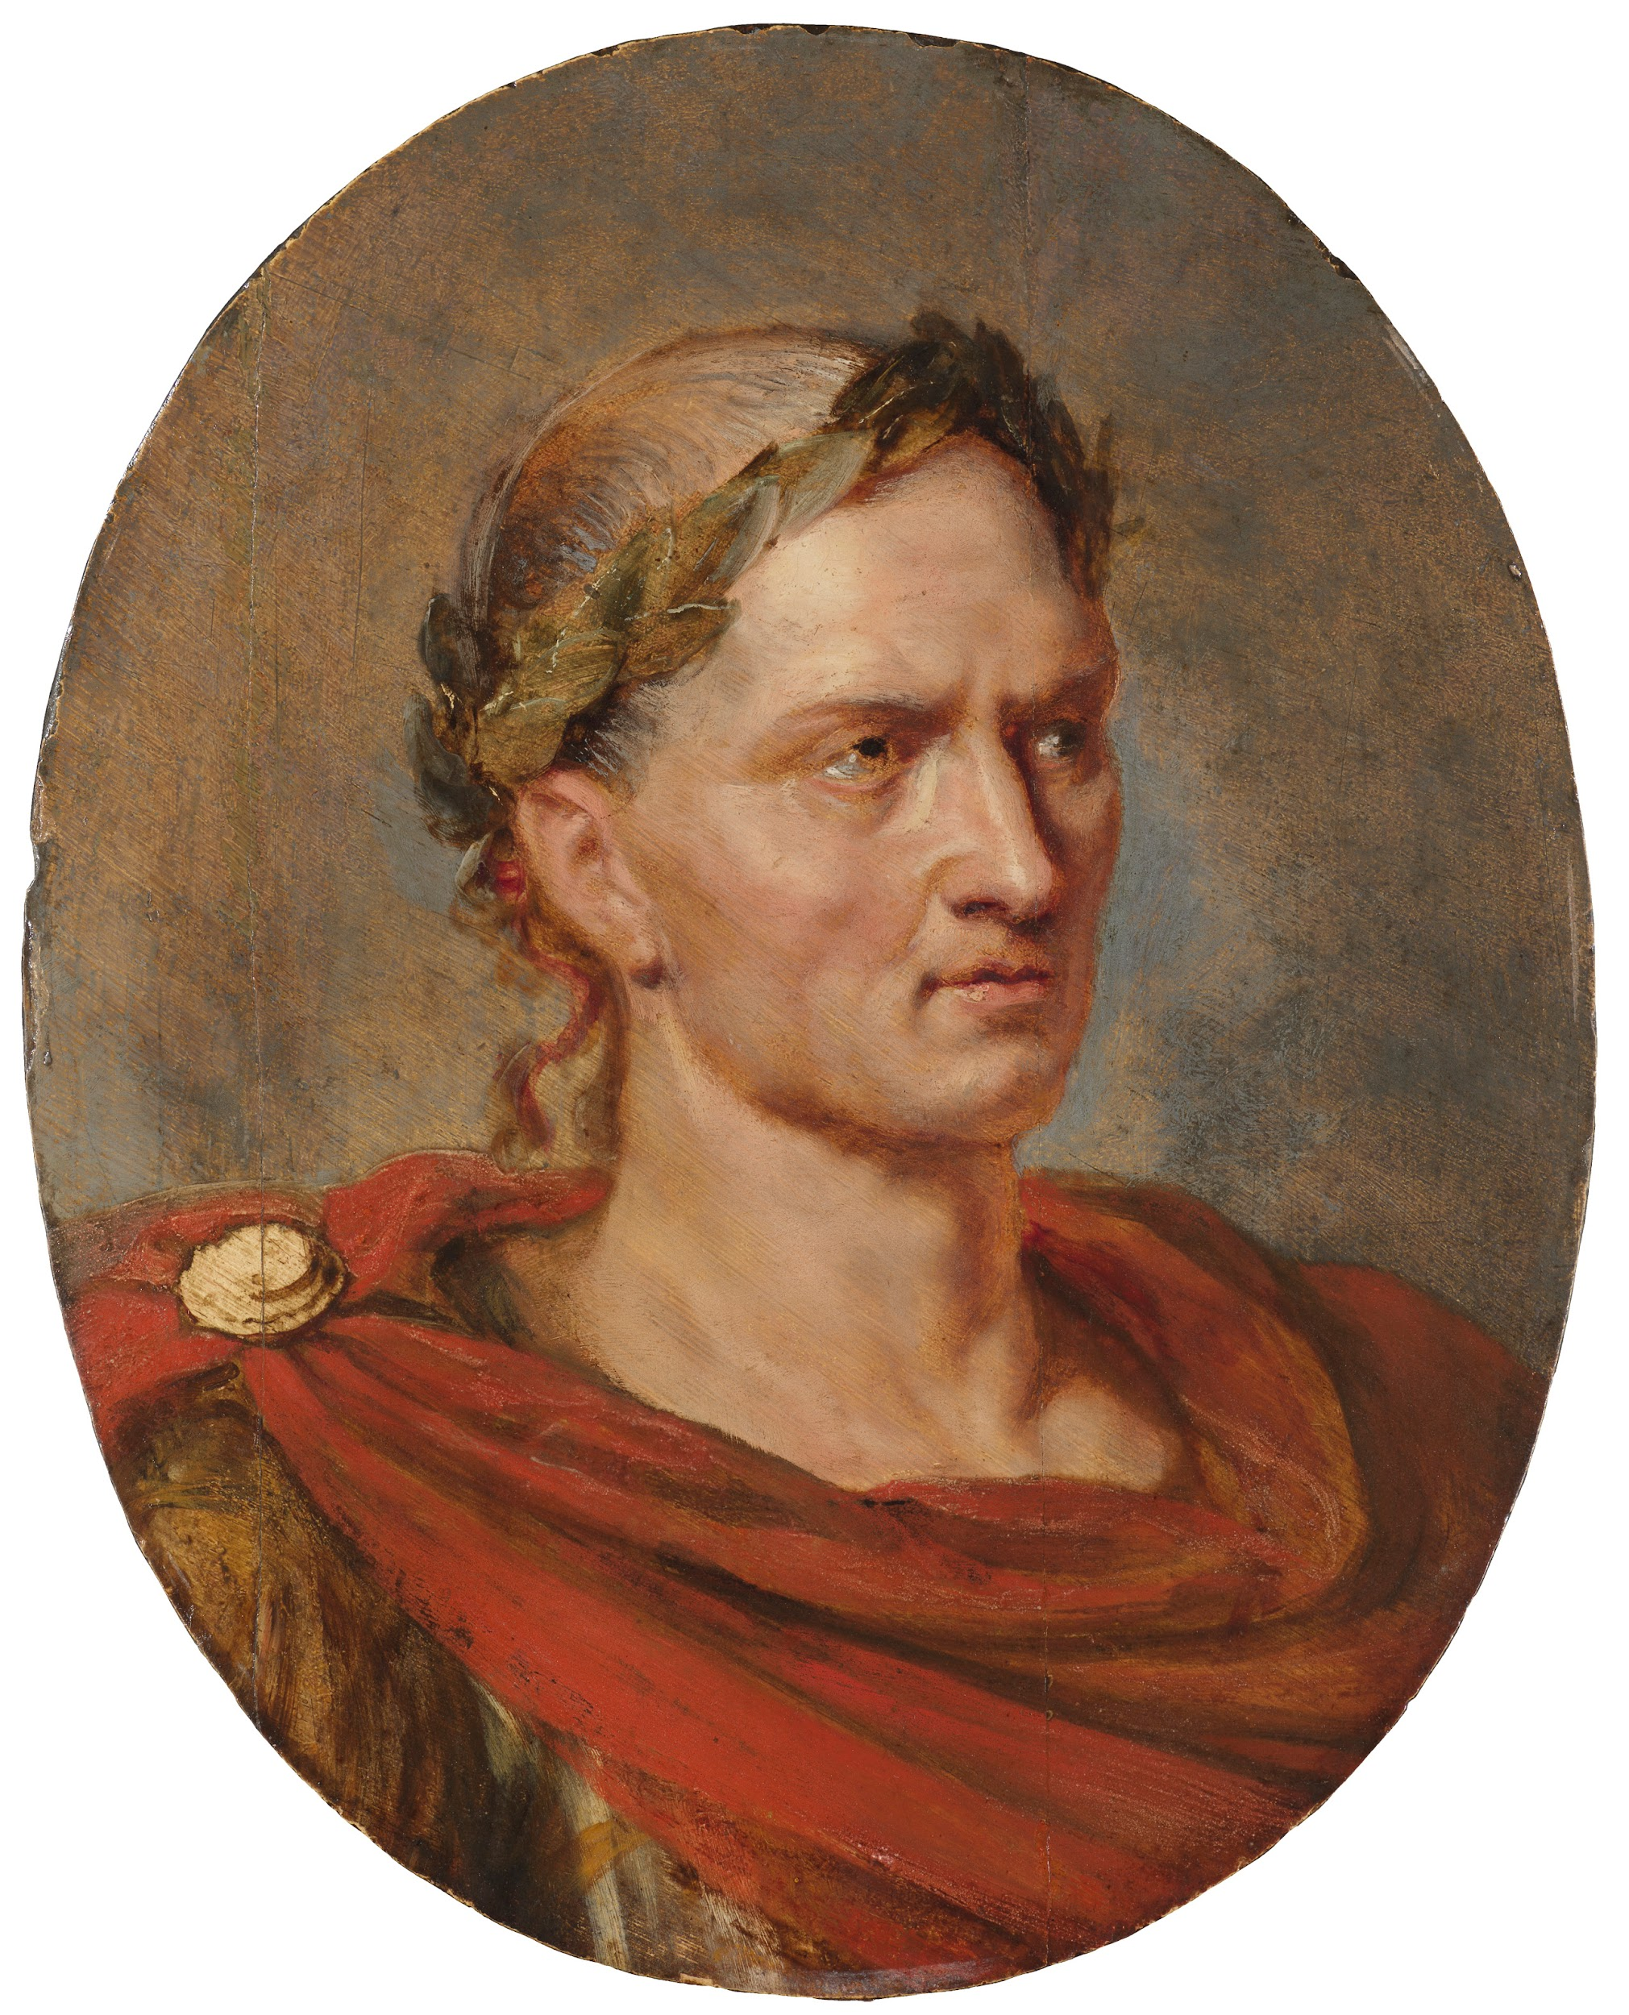
JULIUS CAESAR
He lived in the time of Julius Caesar and Cleopatra.
Cicero although did publicly applause Caesar, he hated him in private.
He often disapproved of Caesar’s power.
Cicero blamed Caesar for the end of the Roman Republic

Slide 7
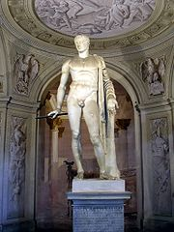
POMPEY THE GREAT
His father was Pompey the Great, statesman and general of the Roman Republic.
His early military career was one of the best of these times. He reconquered Spain, utterly destroyed the army of Spartacus, and destroyed the pirates of the eastern Mediterranean.
In 61 BC he formed the First Triumvirate with Julius Caesar and Marcus Licinius Crassus. After Crassus death in 53, Pompey and Caesar fell out.

Slide 8
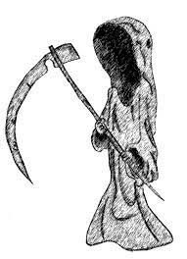
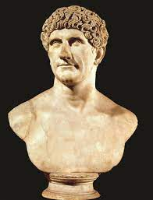
HOW CICERO WAS MURDERED
Cicero was murdered (decapitated) to appease his primary political enemy, Mark Antony.

Slide 9
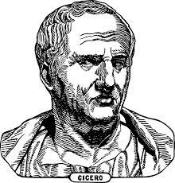
CICERO’S LAST WORDS
“There is nothing proper about what you are doing, soldier, but do try to kill me properly.”
“Ego vero consisto. Accede, veterane, et, si hoc saltim potes recte facere, incide cervicem.

Slide 10
RECAP
Lived in the time of Cleopatra and Caesar.
Was the son of the great pompey
Was murdered by Mark Antony

