Slide 1
Alexandre Dumas 1802-1870
By Lila Logan

Slide 2
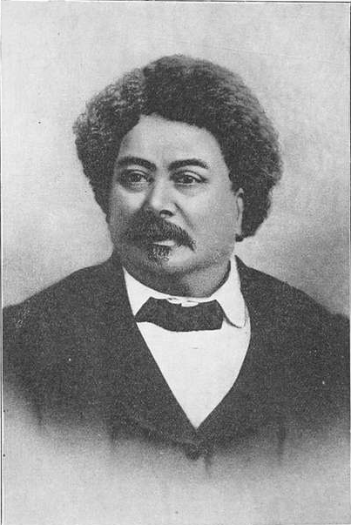
Alexandre Dumas
Dumas’s father, Thomas-Alexandre Davy de La Pailleterie—born out of wedlock to the marquis de La Pailleterie and Marie Cessette Dumas, a black slave of Santo Domingo—was a common soldier under the ancien régime who assumed the name Dumas in 1786.
He later became a general in Napoleon’s army. The family fell on hard times, however, especially after General Dumas’s death in 1806, and the young Alexandre went to Paris to attempt to make a living as a lawyer.
He managed to obtain a post in the household of the Duke d’Orléans, the future King Louis-Philippe, but tried his fortune in the theatre. He made contact with the actor François-Joseph Talma and with the young poets who were to lead the Romantic movement.

Slide 3
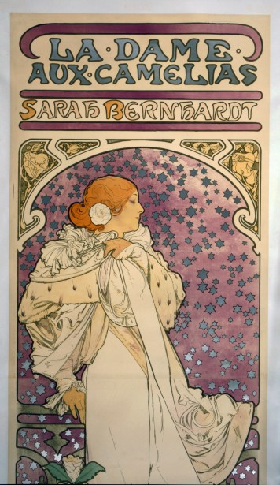
Alexandre Dumas
Alexandre Dumas started writing in newspapers. He would write short stories about The Three Musketeers. The newspaper was very popular so he decided to combine all these stories into one book.
Alexandre Dumas also had a son who was named Alexandre Dumas as well. Both of them became popular writers so in order to tell them apart they are called Alexandre Dumas pere and Alexandre Dumas fils. Alexandre Dumas fils wrote Les Dame aux Camelias which is a famous play, of a different genre..

Slide 4
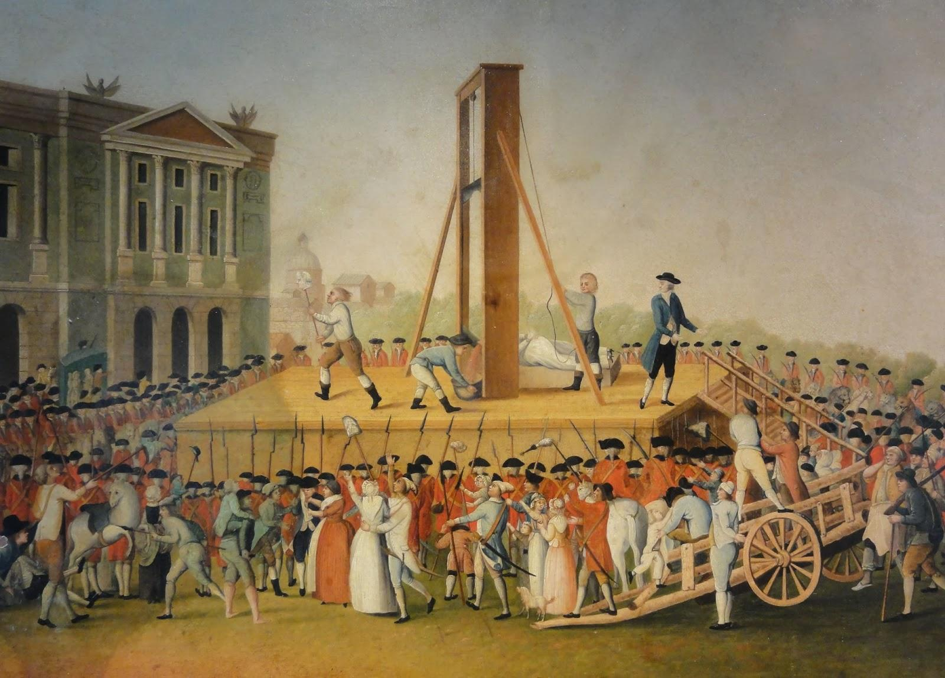
Era
Alexandre Dumas wrote all of his books in the (romantic) Victorian Era. During the Victorian Era, Europe was going through the Industrial Revolution. In this time Queen Victoria was the queen of England. This Era can also be described as the Golden Era with many advances in living standards and economic growth.

Slide 5
Books
Queen Margot (1845)
The Three Musketeers (1844)
Count of Monte Cristo (1846)
Man in the Iron Mask (1850)
The Black Tulip (1850)

Slide 6
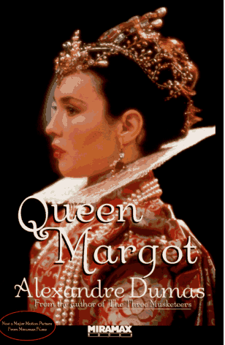
Queen Margot
A historical novel about the about Queen Margot and husband who became the most beloved king of France, Henry IV.
Saint Bartholomew's Day, massacre of French Huguenots (Protestants) in Paris on August 24/25, 1572, plotted by Catherine de' Medici and carried out by Roman Catholic nobles and other citizens. It was one event in the series of civil wars between Roman Catholics and Huguenots that plagued France in the late 16th century.

Slide 7
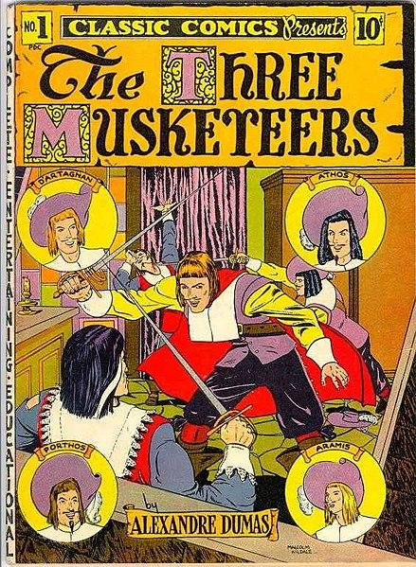
The Three Musketeers
A historical adventure book with four heroes, during the reign of the “sun king”, Louis XIV. The three musketeers go to duel D’Artagnan although become friends with him instead, after being caught for illegal dueling. This story is about their friendship and their many adventures.

Slide 8
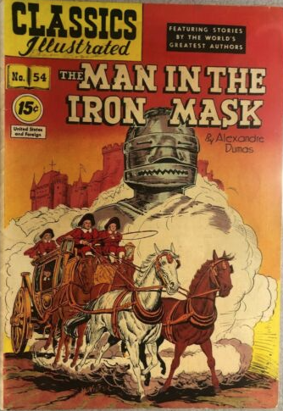
The Man in the Iron Mask
The king of France’s twin brother is hidden from society by being sentenced to a life long imprisonment. He later tries to switches places with the King by the help of the Three Musketeers. Their plan fails and he is put back in jail with an iron mask.

Slide 9
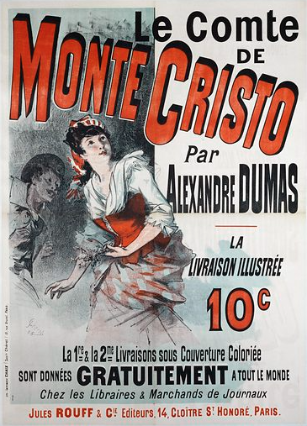
Count of Monte Cristo
This guy has the perfect life, this caused many people to be envious of him. Those people form a plan to have him accused of treason which leads to him to be imprisoned. He then takes on the name of Count of Monte Cristo after escaping from jail and finding treasure. With his newfound wealth he goes out to seek revenge on those who wronged him and help those who were loyal.

Slide 10
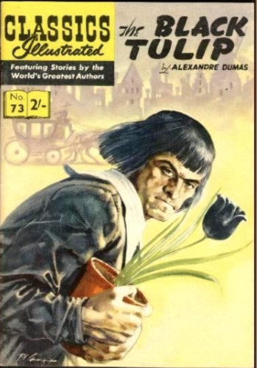
The Black TUlip
This historical novel is set in 1652 in the Netherlands. In the Netherlands in the mid-1600s there was a tulip craze called tulipmania. People were paying almost a million dollars, in today’s money, for one tulip. Tulips were a sign of wealth, you would have had bad taste if you did not own a tulip. This book is about a man named Cornelius who is trying to create a black tulip and to get a prize for his work. As soon as he becomes close to his goal he is imprisoned. Until the daughter of the jailer, Rosa, rescues him.

Slide 11
Recap
To summarize Alexandre Dumas was a very prolific writer who wrote many famous books.
Many of his books included the Three Musketeers and was set during the 17th century.
He had a son who was a famous writer as well.

